Slide 1
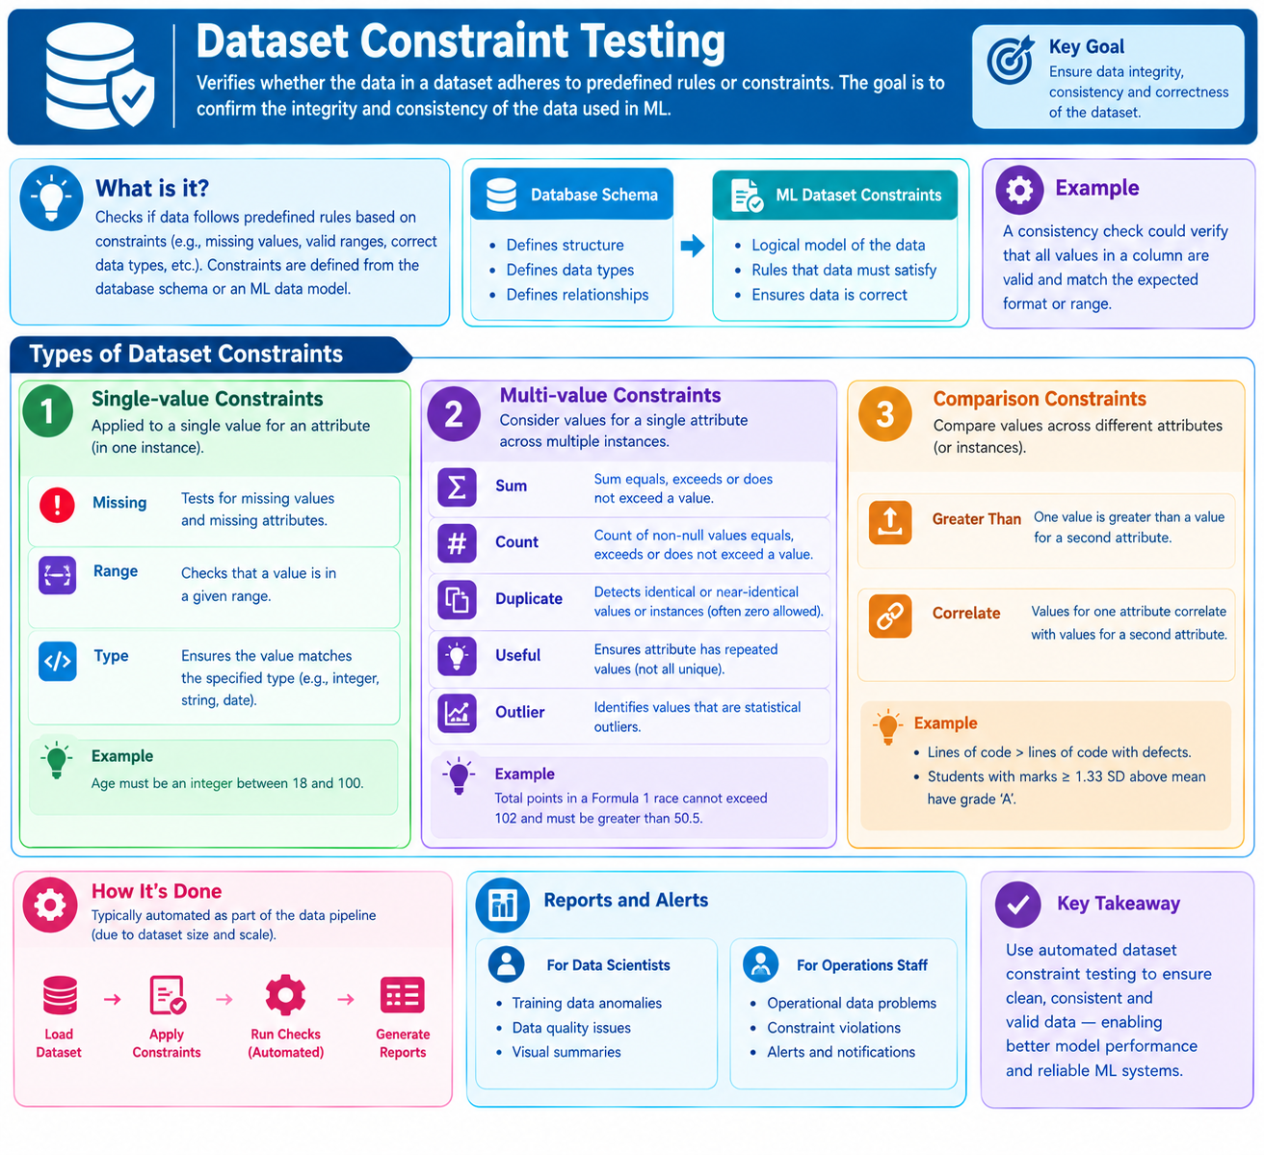
5.1.5 Dataset Constraint Testing

Slide 2
5.1.5 Dataset Constraint Testing
Dataset constraint testing verifies whether the data in a dataset follows predefined rules or constraints. The main objective is to ensure the integrity, accuracy, consistency, and quality of the data used in Machine Learning (ML) systems.
For example, dataset constraint testing can verify that age values are within an acceptable range, required fields are not empty, and duplicate records are not present.
Understanding Dataset Constraints
Data constraints are commonly defined in database schemas. A database schema specifies the structure, data types, and relationships between different data elements.
Similarly, in Machine Learning datasets, constraints define a logical model of how the data should appear. If the dataset is correct, it should satisfy these constraints.
Dataset constraints can be classified into three main categories:
Single-Value Constraints
Multi-Value Constraints
Comparison Constraints

Slide 3
5.1.5 Dataset Constraint Testing
Single-Value Constraints
Single-value constraints are applied to an individual attribute value within a single record or instance of a dataset.
These constraints verify whether each value satisfies the specified condition.
a. Missing Value Constraint
Missing value constraints verify whether the dataset contains missing values or missing attributes.
For example, in a student dataset, attributes such as Student ID, Name, and Marks may be mandatory. If any required attribute is missing, the constraint test fails.
b. Range Constraint
Range constraints verify whether an attribute value falls within a specified minimum and maximum range.
For example, if student marks must be between 0 and 100, any value below 0 or above 100 violates the range constraint.
c. Type Constraint
Type constraints verify whether an attribute contains values of the correct data type.
For example, if the Age attribute is defined as an integer, values such as "Twenty" or 25.5 violate the integer type constraint.

Slide 4
5.1.5 Dataset Constraint Testing
2. Multi-Value Constraints
a. Sum Constraint: Verifies whether the sum of multiple values satisfies a specified limit (e.g., total race points must not exceed 102).
b. Count Constraint: Verifies whether the number of valid or non-null records meets a specified requirement (e.g., at least 1,000 customer records).
c. Duplicate Constraint: Identifies identical or nearly identical records in a dataset (e.g., duplicate customer IDs).
d. Useful Value Constraint: Checks whether an attribute contains meaningful patterns useful for ML training (e.g., unique customer IDs may not help in prediction).
- e. Outlier Constraint: Identifies values that are unusually different from other values in the dataset (e.g., a salary of ₹50 lakh when most salaries are below ₹1 lakh).

Slide 5
5.1.5 Dataset Constraint Testing
3. Comparison Constraints
a. Greater Than Constraint: Verifies whether one attribute's value is greater than another attribute's value (e.g., total lines of code must exceed defective lines of code).
- b. Correlation Constraint: Verifies whether two attributes follow an expected relationship (e.g., students scoring significantly above average should receive grade 'A').

Slide 6
5.1.5 Dataset Constraint Testing
4. Manual and Automated Dataset Constraint Testing
Dataset constraint testing can be performed manually, but large ML datasets require automation as part of the data pipeline to ensure data quality and consistency.
Automated testing helps to:
Validate data against predefined rules.
Detect missing values, incorrect data types, duplicates, and outliers.
Identify records that violate constraints.
Generate data quality reports.
Prevent incorrect data from being used for ML model training.

Slide 7
5.1.5 Dataset Constraint Testing
Summary of Dataset Constraint Testing
Constraint Type | Constraint | Purpose
Single-Value | Missing | Detect missing values or attributes
Single-Value | Range | Verify values are within specified limits
Single-Value | Type | Verify correct data types
Multi-Value | Sum | Validate the total of multiple values
Multi-Value | Count | Verify the number of valid records or values
Multi-Value | Duplicate | Detect identical or nearly identical records
Multi-Value | Useful | Identify attributes with limited predictive usefulness
Multi-Value | Outlier | Detect statistically unusual values
Comparison | Greater Than | Compare values between attributes
Comparison | Correlate | Verify expected relationships between attributes

Slide 8
5.1.5 Dataset Constraint Testing
Simple Example: Student Dataset
Consider the following dataset used to train a Machine Learning model that predicts student performance.
Sample dataset
Run constraint tests
Select "Run constraint tests" to identify records that violate the dataset rules.
ID | Age | Marks | Grade
101 | 20 | 85 | A
102 | 21 | 75 | B
103 | 19 | 110 | A
104 | Missing | 65 | C
104 | 22 | 90 | A

Slide 9
5.1.5 Dataset Constraint Testing
This example demonstrates how dataset constraint testing identifies incorrect values, missing information, and duplicate identifiers before the dataset is used for ML training.
Key Takeaway: Dataset constraint testing ensures that Machine Learning datasets follow predefined data quality rules. It uses single-value, multi-value, and comparison constraints to detect errors and inconsistencies. Automating these tests as part of the data pipeline helps prevent poor-quality data from affecting ML model training and predictions.

Slide 10
THANK YOU!!!

